Slide 1
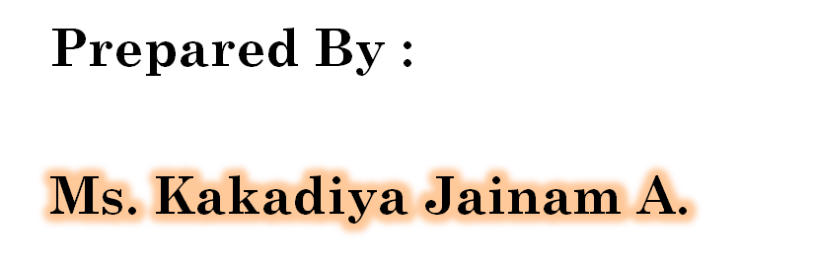
J2EE
UNIT – 5
Spring & Struts
Notes:
MONARCH Computer
By : Manoharsinh Gohil : Mo. 9429220505

Slide 2
INTRODUCTION OF SPRING FRAMEWORK
Spring is the most popular application development framework for enterprise Java.
Millions of developers around the world use Spring Framework to create high performing, easily testable, reusable code.
Spring framework is an open source Java platform and it was initially written by Rod Johnson and was first released under the Apache 2.0 license in June 2003.

Slide 3
The core features of the Spring Framework can be used in developing any Java application, but there are extensions for building web applications on top of the Java EE platform.
Spring framework targets to make J2EE development easier to use and promote good programming practice by enabling a POJO-based programming model.

Slide 4
SPRING FRAMEWORK ARCHITECTURE
The basic architecture of the framework and its main building blocks which are called “modules” in software terminology.
Spring could potentially be a one-stop shop for all your enterprise applications, however, Spring is modular, allowing you to pick and choose which modules are applicable to you, without having to bring in the rest.

Slide 5
The Spring Framework provides about 20 modules which can be used based on an application requirement.
Following section gives detail about all the modules available in Spring Framework.

Slide 6
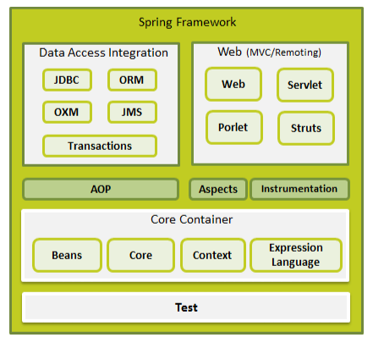

Slide 7
CORE CONTAINER
• The Core module provides the fundamental parts of the framework, including the IoC and Dependency Injection features.
• The Bean module provides BeanFactory which is a sophisticated implementation of the factory pattern.
• The Context module builds on the solid base provided by the Core and Beans modules and it is a medium to access any objects defined and configured.
• The Expression Language module provides a powerful expression language for querying and manipulating an object graph at runtime.

Slide 8
SPRING APPLICATION CONTEXT
The Application Context is spring's more advanced container. Similar to BeanFactory it can load bean definitions, wire beans together and dispense beans upon request.
Additionally it adds more enterprise-specific functionality such as the ability to resolve textual messages from a properties file and the ability to publish application events to interested event listeners.

Slide 9
The ApplicationContext includes all functionality of the BeanFactory, it is generally recommended over the BeanFactory.
The most commonly used ApplicationContext implementations are:
• FileSystemXmlApplicationContext: This container loads the definitions of the beans from an XML file. Here you need to provide the full path of the XML bean configuration file to the constructor.

Slide 10
• ClassPathXmlApplicationContext :
  This container loads the definitions of the beans from an XML file. Here you do not need to provide the full path of the XML file but you need to set CLASSPATH properly because this container will look bean configuration XML file in CLASSPATH.
• WebXmlApplicationContext:
  This container loads the XML file with definitions of all beans from within a web application.

Slide 11
SPRING IOC CONTAINERS
The IOC Spring container is at the core of the Spring Framework.
The container will create the objects, wire them together, configure them, and manage their complete lifecycle from creation till destruction.
The Spring container uses dependency injection (DI) to manage the components that make up an application. These objects are called Spring Beans.

Slide 12
ASPECT ORIENTED PROGRAMMING (AOP)
One of the key components of Spring is the Aspect oriented programming (AOP) framework. The functions that span multiple points of an application are called cross-cutting concerns and these cross-cutting concerns are conceptually separate from the application's business logic.
There are various common good examples of aspects including logging, declarative transactions, security, and caching etc.

Slide 13
AOP WITH SPRING FRAMEWORK
One of the key components of Spring Framework is the Aspect oriented programming (AOP)framework.
Aspect Oriented Programming entails breaking down program logic into distinct parts called so-called concerns.
The functions that span multiple points of an application are called cross-cutting concerns and these cross-cutting concerns are conceptually separate from the application's business logic.

Slide 14
Struts
Notes:
MONARCH Computer
By : Manoharsinh Gohil : Mo. 9429220505

Slide 15
STRUTS 2 OVERVIEW
Struts2 is popular and nature web application framework based on the MVC design pattern. Struts2 is not just the next version of Struts 1, but it is a complete rewrite of the Struts architecture.
The Web Work framework started off with Struts framework as the basis and its goal was to offer an enhanced and improved framework built on Struts to make web development easier for the developers.

Slide 16
STRUTS ARCHITECTURE
From a high level, Struts is a pull-MVC (or MVC2) framework. The Model-View-Controller pattern in Struts2 is realized with following five core components:
Actions
Interceptors
Value Stack /
Results / Result types
View technologies

Slide 17
Struts 2 is slightly different from a traditional MVC framework in that the action takes the role of the model rather than the controller, although there is some overlap.
The below diagram depicts the Model, View and Controller to the Struts2 high level architecture.
The controller is implemented with a Struts2 dispatch servlet filter as well as interceptors, the model is implemented with actions, and the view as a combination of result types and results.

Slide 18
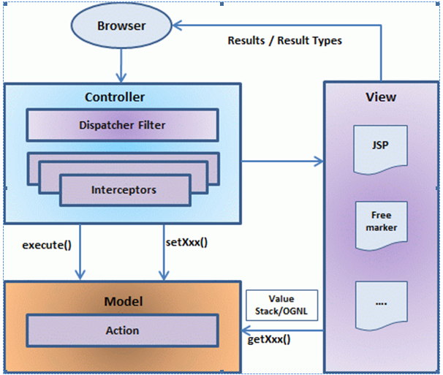

Slide 19
STRUTS 2 ACTIONS
Actions are the core of the Struts2 framework, as they are for any MVC (Model View Controller) framework. Each URL is mapped to a specific action, which provides the processing logic necessary to service the request from the user.
But the action also serves in two other important capacities. First, the action plays an important role in the transfer of data from the request through to the view, whether its a JSP or other type of result.

Slide 20
CREATE A VIEW
Let us create the below jsp file HelloWorld.jsp in the WebContent folder in your eclipse project.
To do this, right click on the WebContent folder in the project explorer and select New >JSP File.
This file will be called in case return result is SUCCESS which is a String constant "success" as defined in Action interface:

Slide 21
FLOW OF STRUTS CONTROL
Struts implements the MVC pattern through the use of ActionForwards and ActionMappings to keep control-flow decisions out of presentation layer.
Having received the request the ActionServlet locates the correct Form Bean from the struts-config.xml. The ActionServlet invokes the FormBean Validator logic.

Slide 22
COMPARISION WITH MVC USING REQUESTDISPATCHER & EL
A RequestDispatcher is an extremely important JavaSW class that allows for 'including' content in a request/response or 'forwarding' a request/response to a resource.
In Model-View-Controller programming in Java, a servlet typically serves as the 'controller'. The controller basically contains or references code to perform particular actions, and it decides which 'view' to send the user to.

